Slide 1


Xcode Career Service
有任何问题，请咨询 xc0d3@outlook.com

Slide 2
N students {0, ..., N-1} participate in a marathon. - You are given A[N] and A[i] = j means that student j finished just before student i.
A[k] = -1 means that k is the first student. - No tie.
List out the students in the order in which they finished the marathon.
A[0] = -1
A[1] = 0
A[2] = 1
input: A [-1, 0, 1]
output: [0, 1, 2]

Slide 3
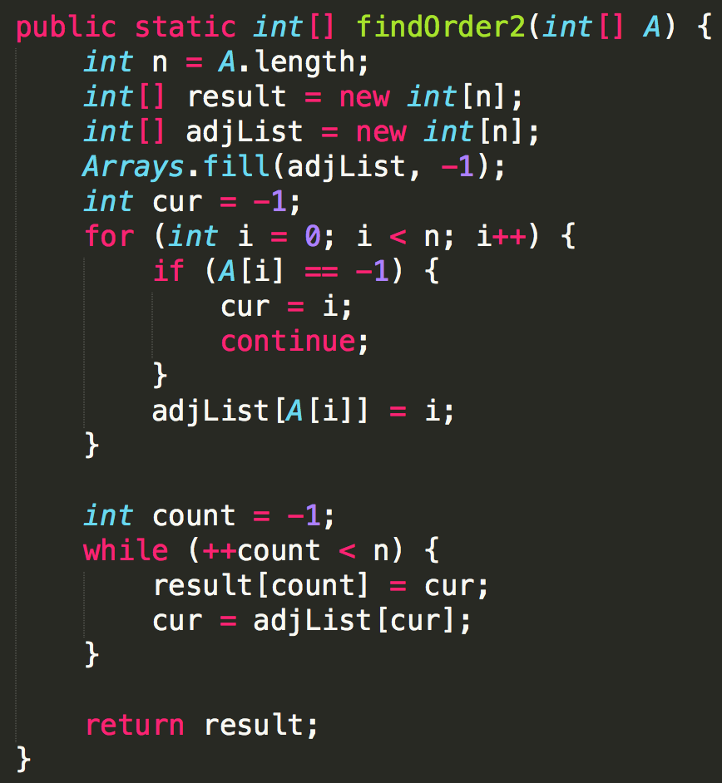
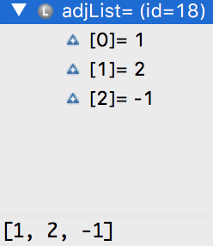

Slide 4
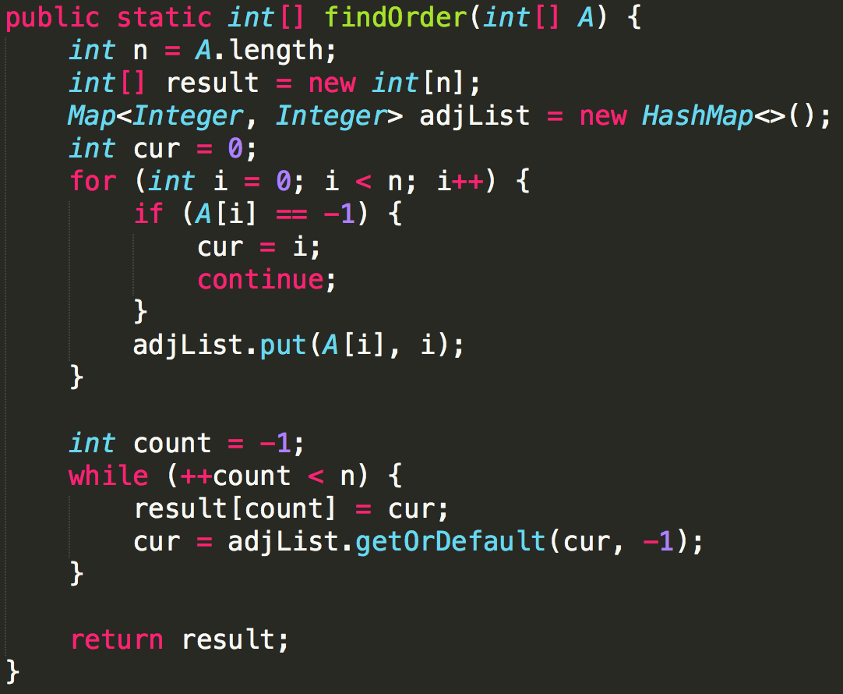
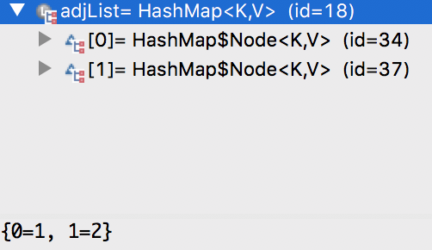

Slide 5

Follow up
Topological Sort

Slide 6
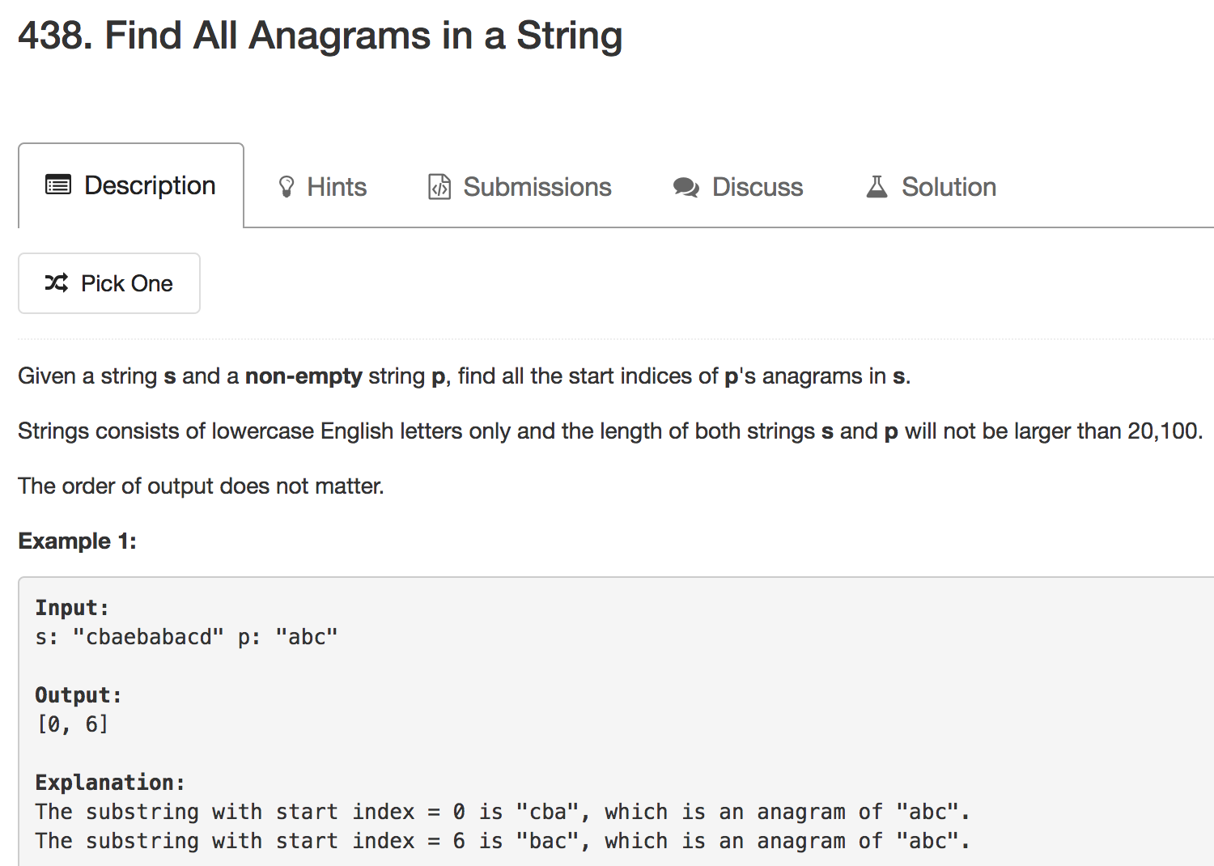

Slide 7
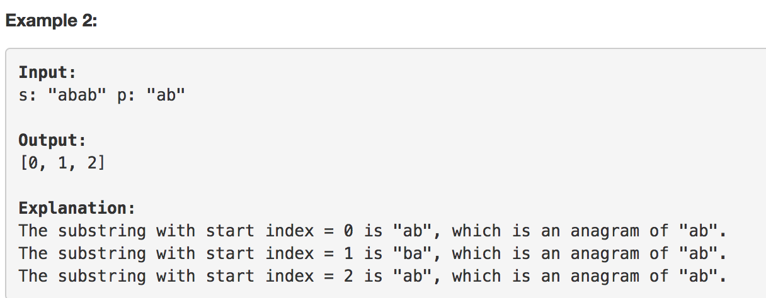
int[] hash = new int[256] or new int[26]
Map<Character, Integer> counts = new HashMap<>()

Slide 8
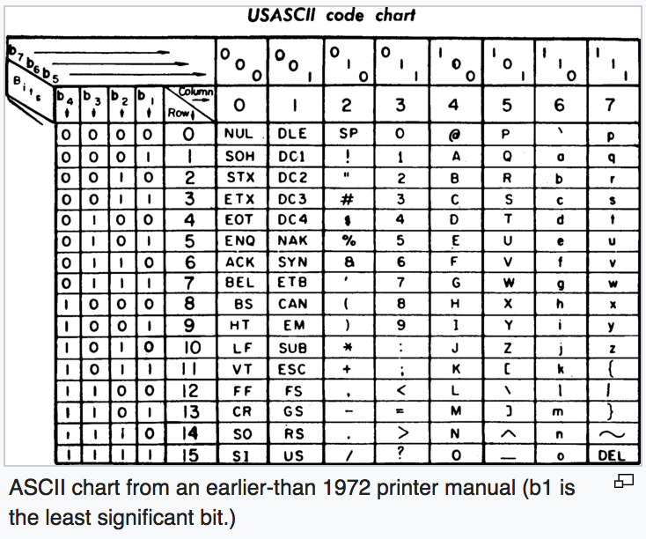
There are 256 ASCII characters. This includes standard ASCII characters(0-127) and Extended ASCII characters(128-255).
ASCII码占用一个字节，可以有0～255共256个取值。前128个为常用的字符如运算符，字母 ，数字等 键盘上可以显示的后 128个为 特殊字符是键盘上找不到的字符。
ASCII 是基于拉丁字母的一套电脑编码系统，主要用于显示现代英语和其他西欧语言。它是现今最通用的单字节编码系统，并等同于国际标准ISO/IEC 646。
Notes:
https://stackoverflow.com/questions/27679137/what-does-256-means-for-128-unique-characters-in-ascii-table

Slide 9

Mock Interview
Count X

Slide 10


Slide 11
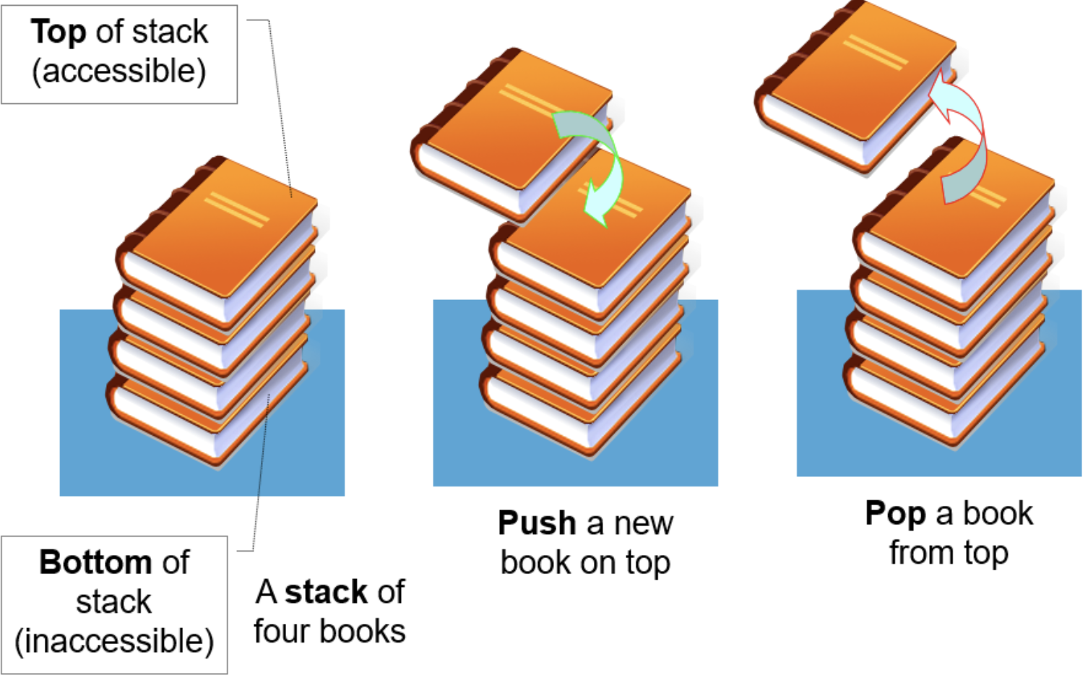

Slide 12
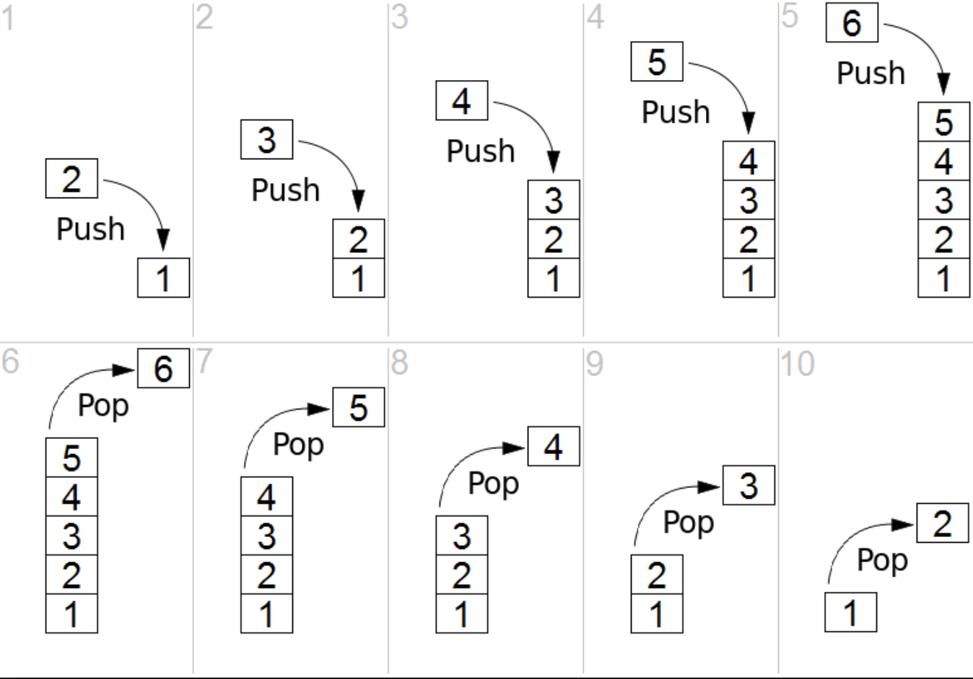
Stack

Slide 13
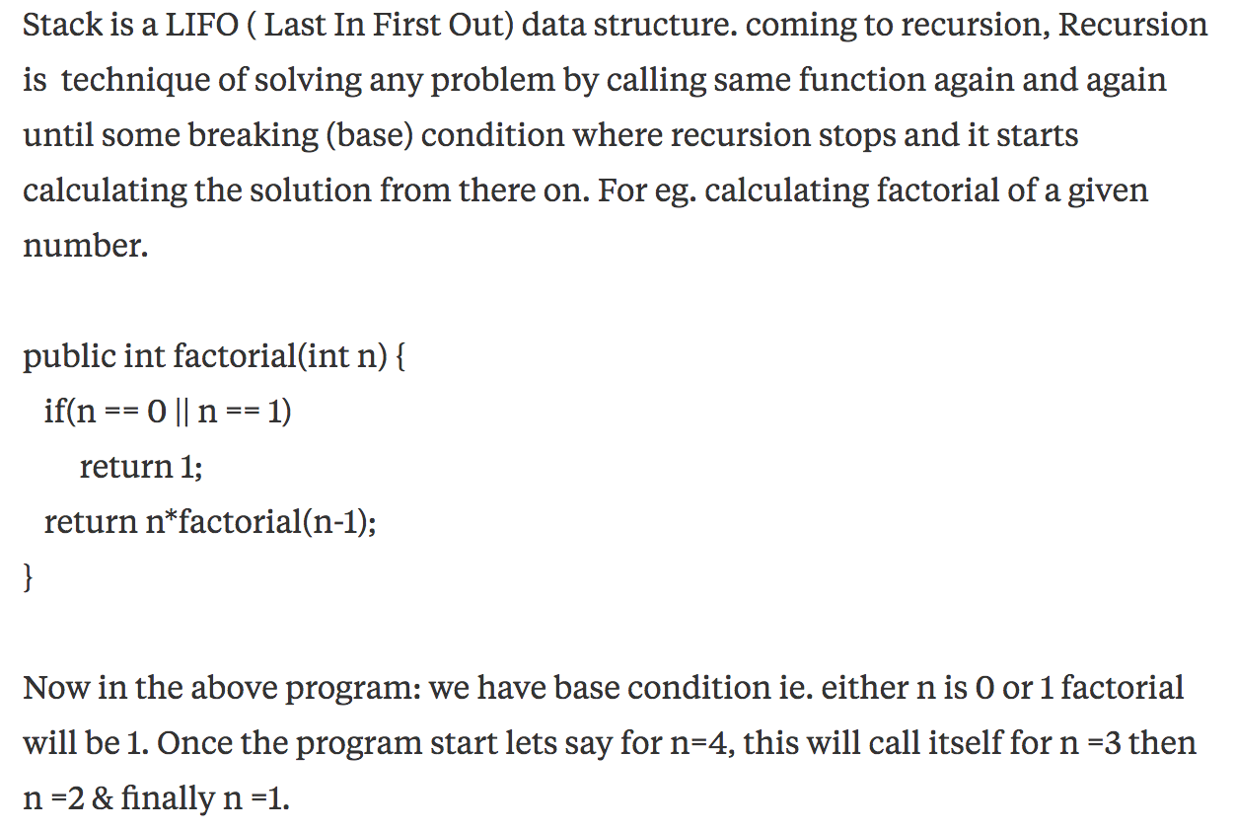

Slide 14
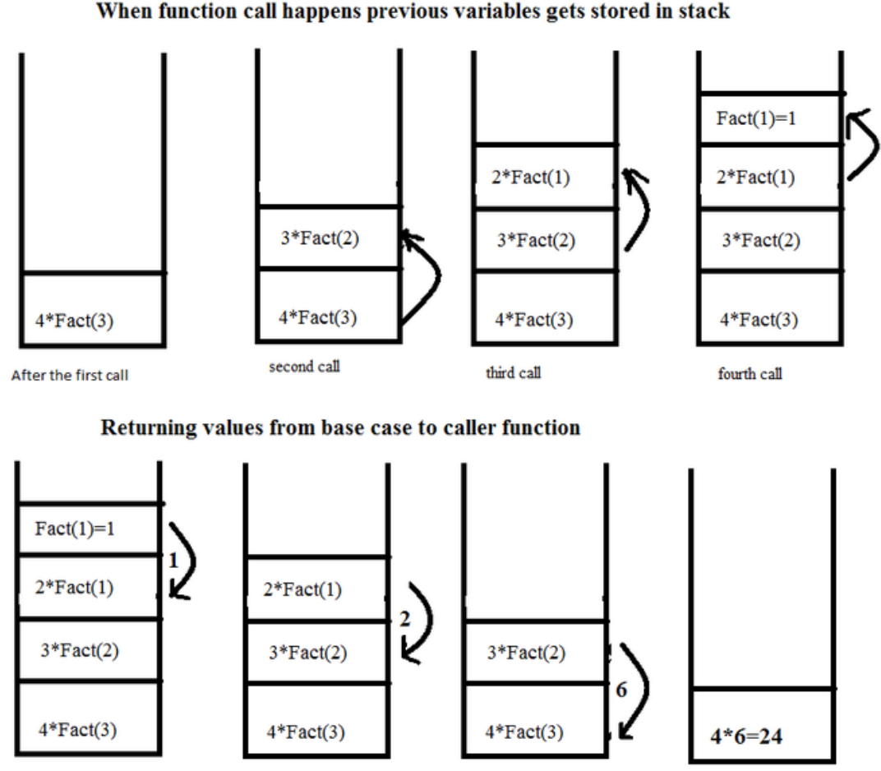

Slide 15
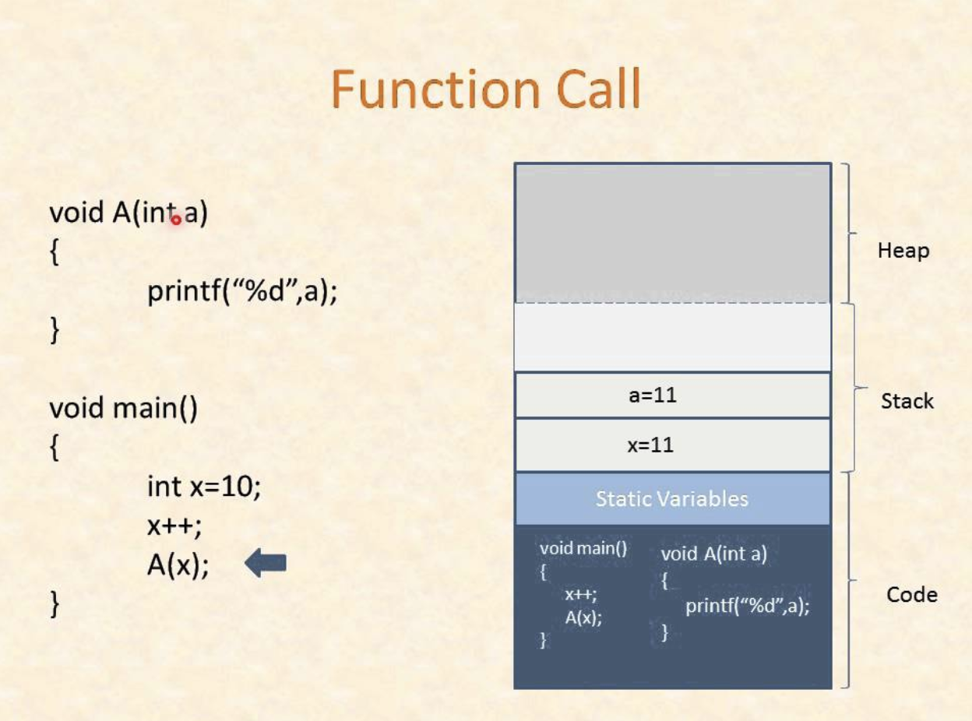
Notes:
https://www.youtube.com/watch?v=ygK0YON10sQ

Slide 16
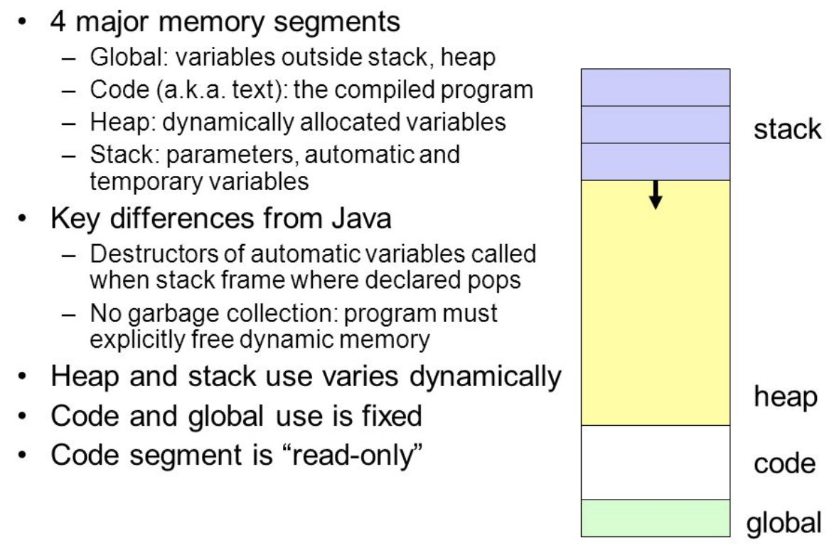

Slide 17

Stack Overflow
Recursive v.s. Iterative

Slide 18
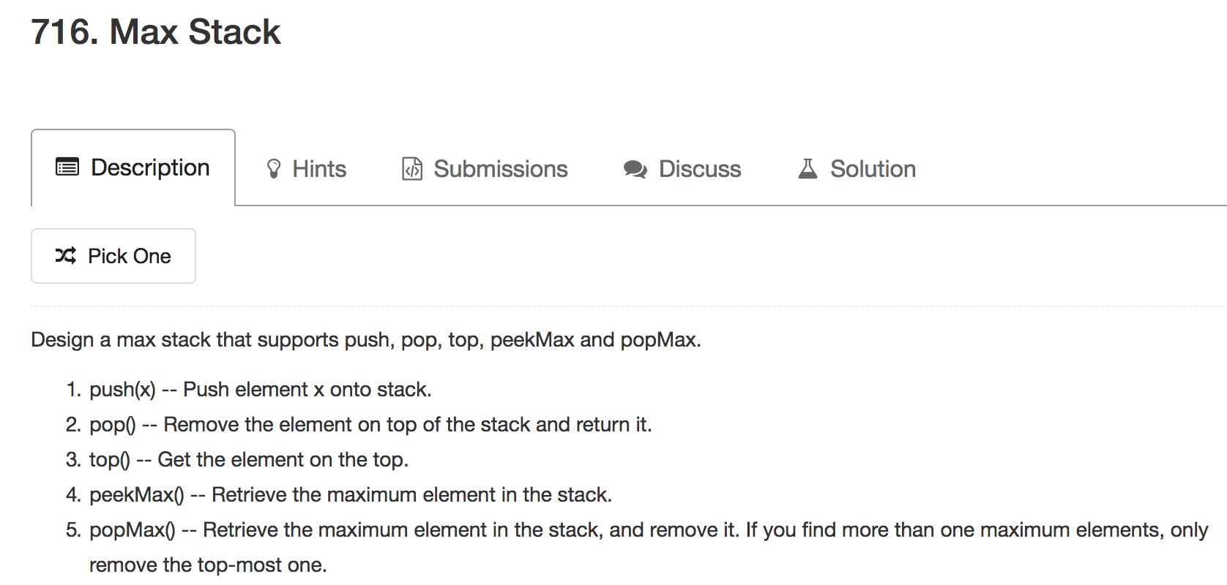

Slide 19
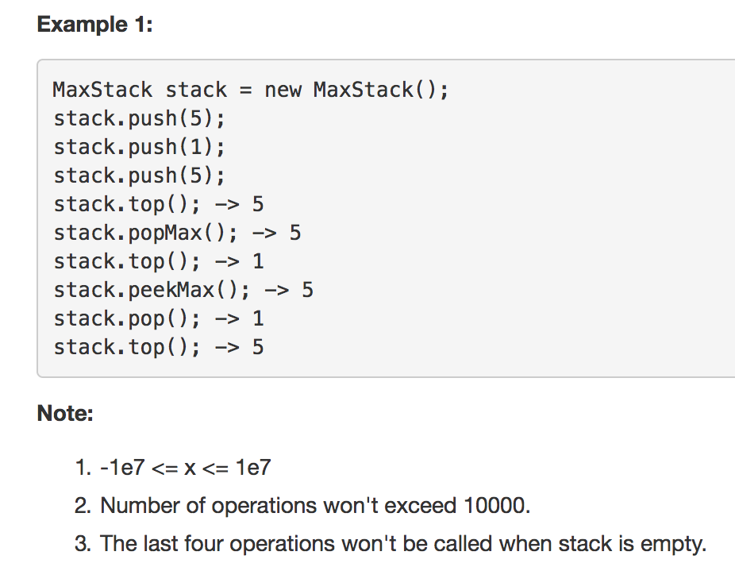

Slide 20

Double Linked List
+
TreeMap

Slide 21
Double Linked List
Queue
FIFO – First In First Out

Slide 22
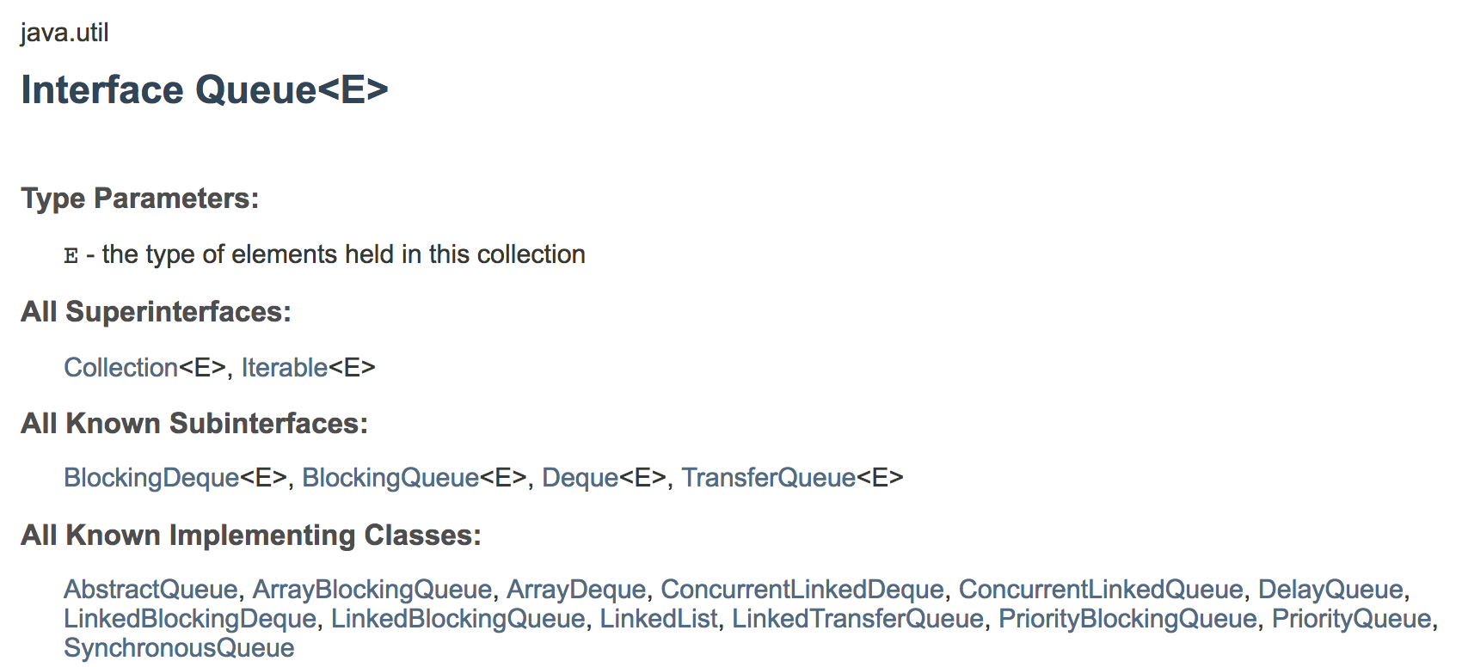

Slide 23
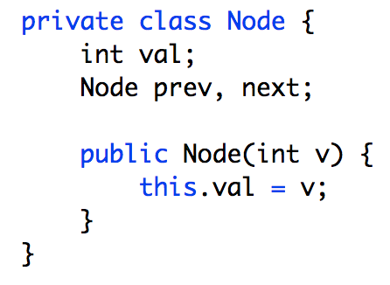
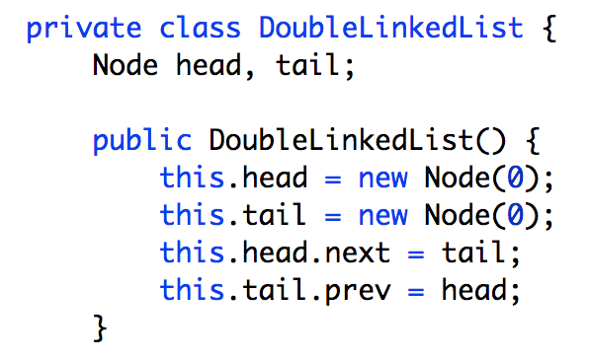
Dummy Nodes
head
prev
next
tail

Slide 24
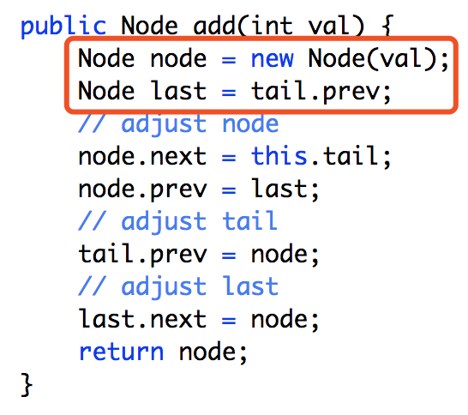
last
node
tail

Slide 25
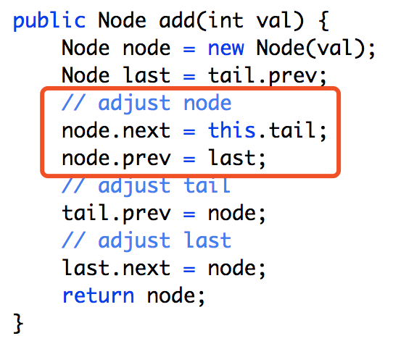
last
node
tail

Slide 26
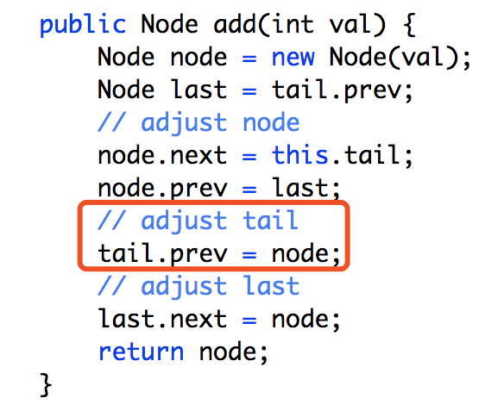
last
node
tail

Slide 27
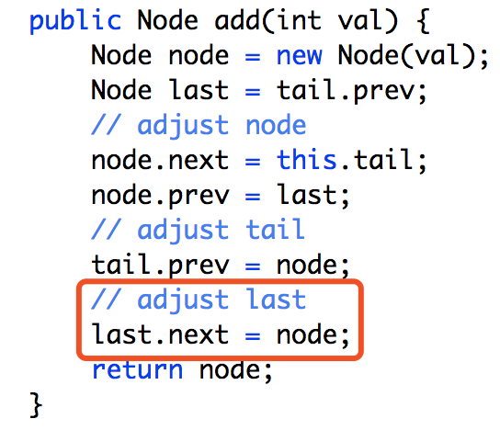
last
node
tail

Slide 28
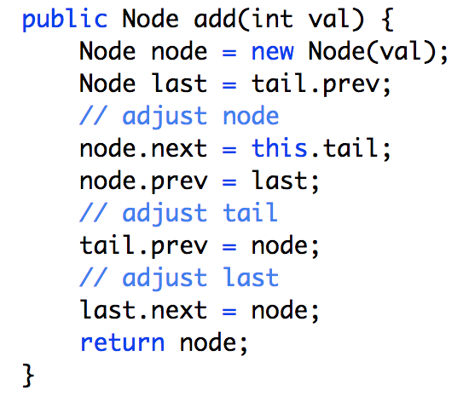
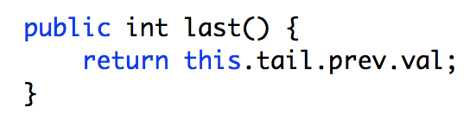
last
tail

Slide 29
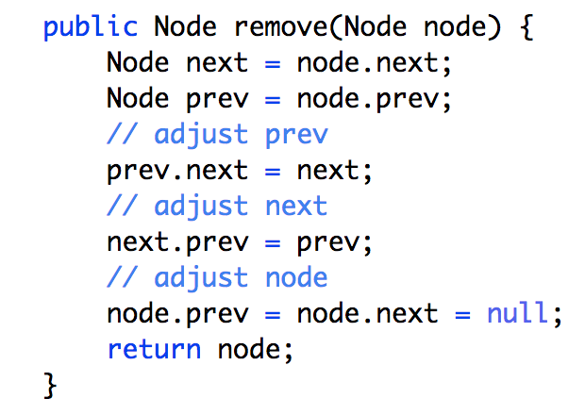
prev
node
next

Slide 30
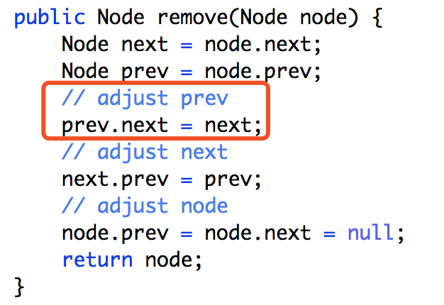
prev
node
next

Slide 31
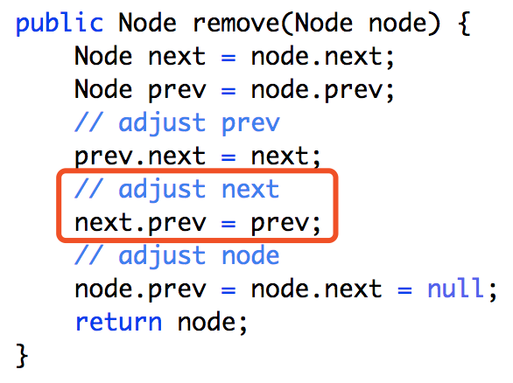
prev
node
next

Slide 32
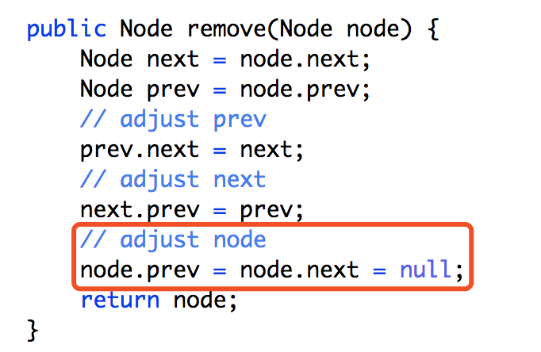
prev
node
next

Slide 33
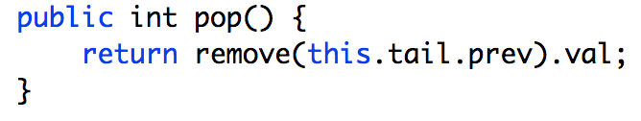
last
tail

Slide 34
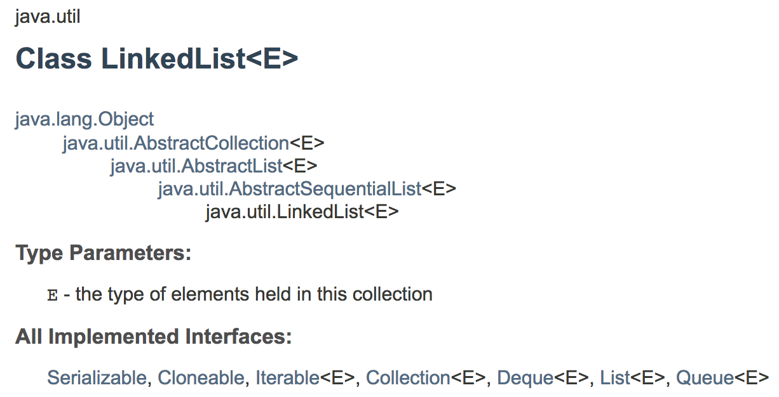

Slide 35
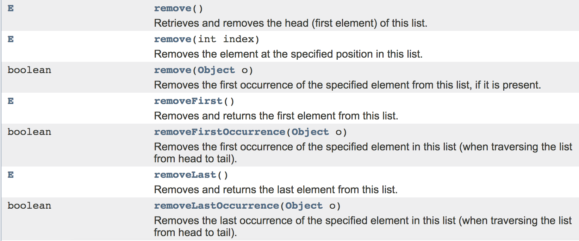

Slide 36
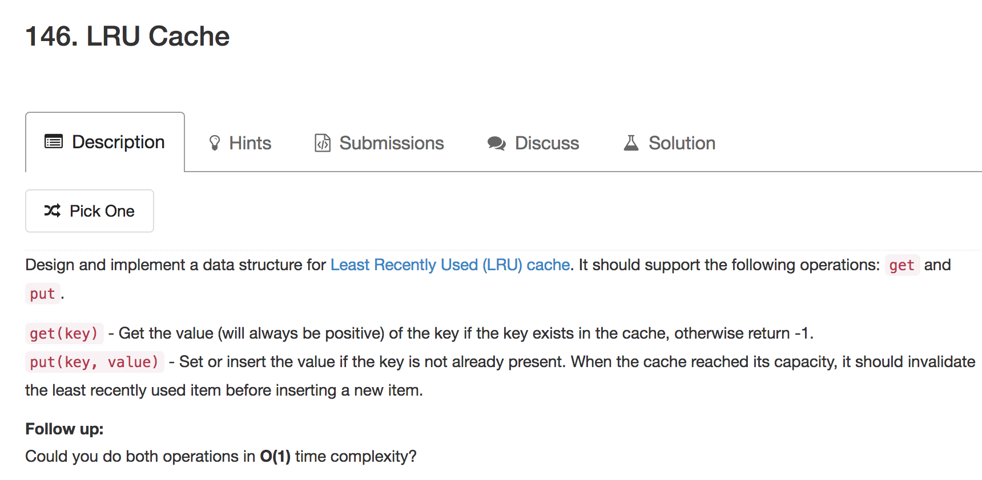

Slide 37
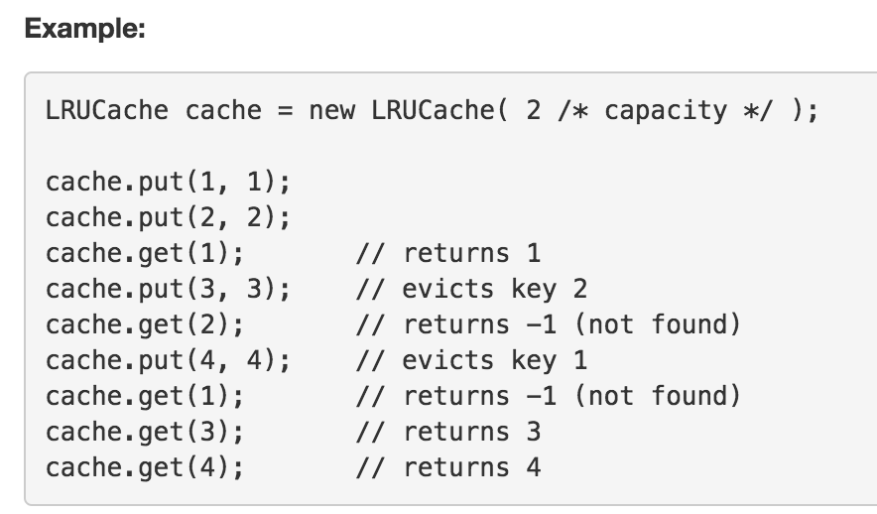

Slide 38

HashMap + LinkedList
Why not just use
java.util.LinkedList?
Notes:
https://docs.oracle.com/javase/7/docs/api/java/util/LinkedList.html

Slide 39


Slide 40
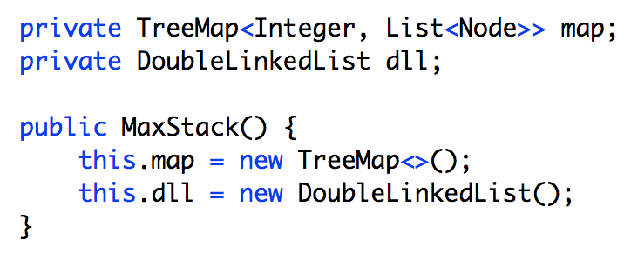
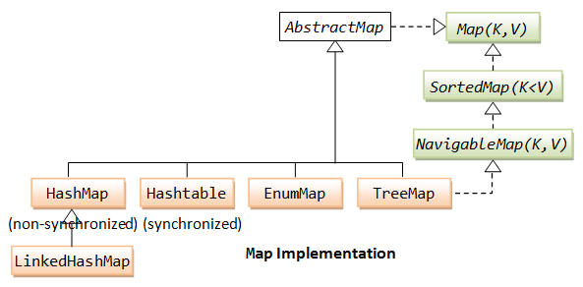

Slide 41
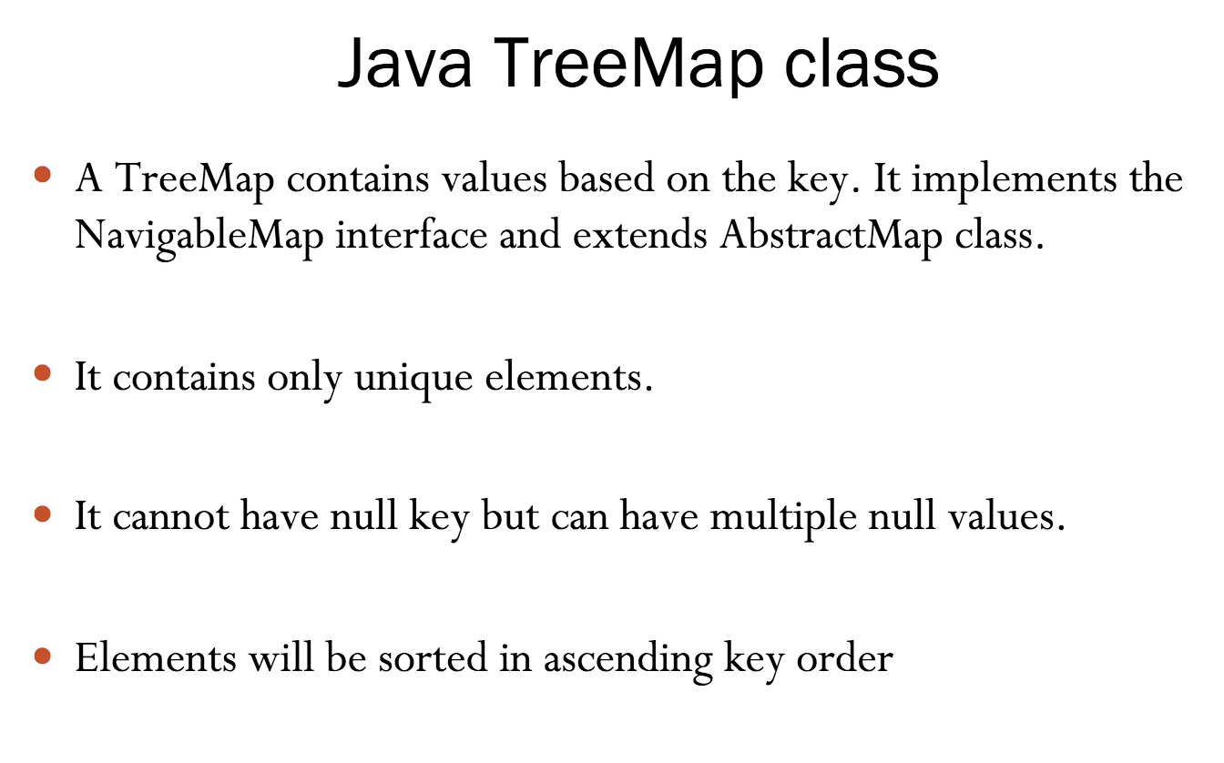

Slide 42
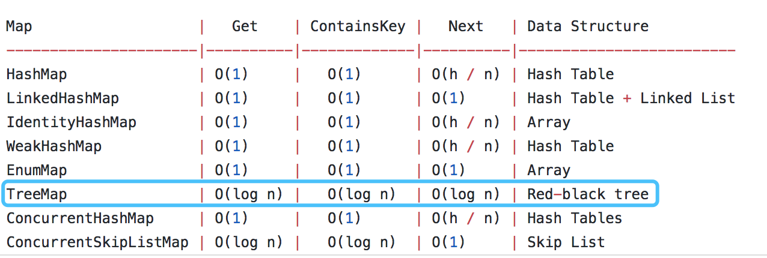
https://gist.github.com/psayre23/c30a821239f4818b0709
Notes:
https://gist.github.com/psayre23/c30a821239f4818b0709

Slide 43
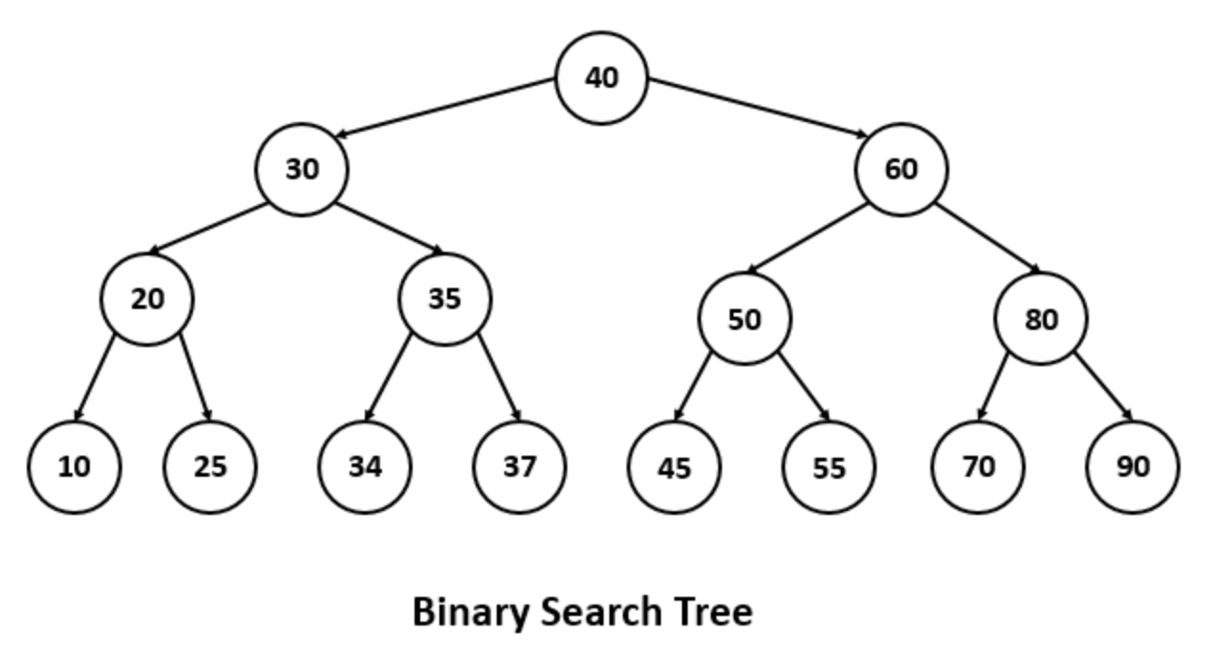
Runtime
O(log(n))
Go to rightest leaf

Slide 44
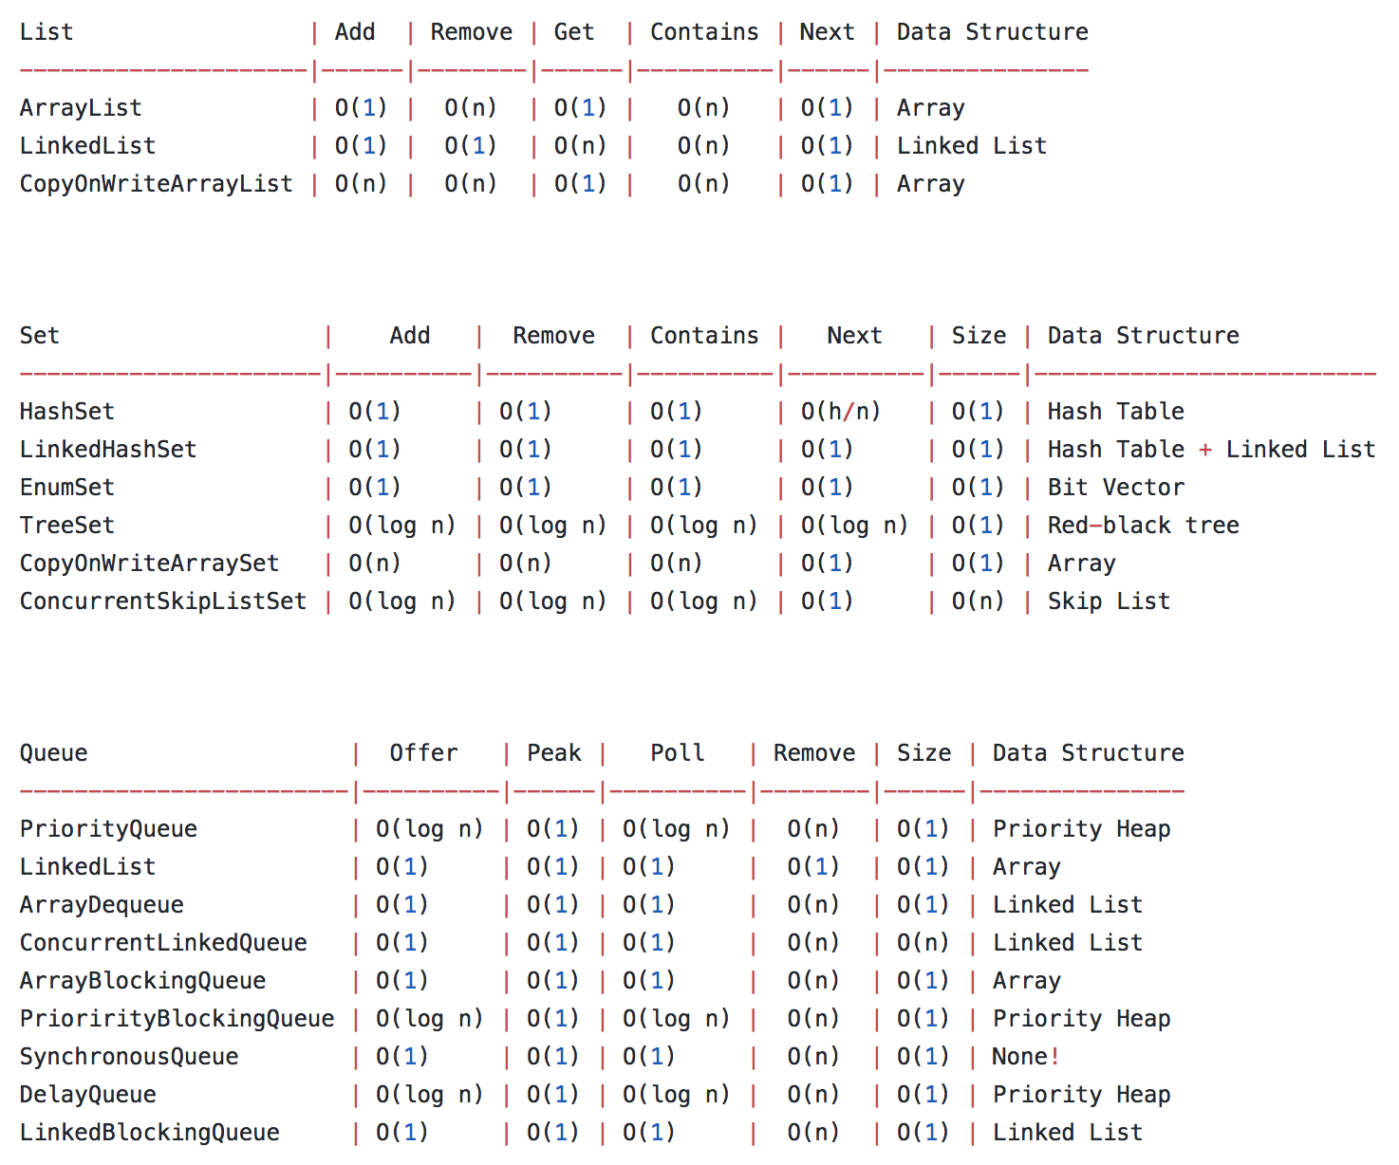

Slide 45
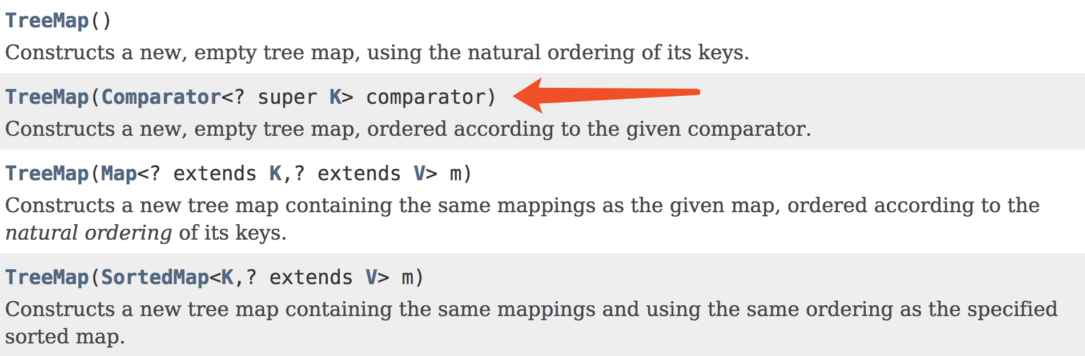
new TreeMap<K, T>(Collections.reverseOrder())

Slide 46
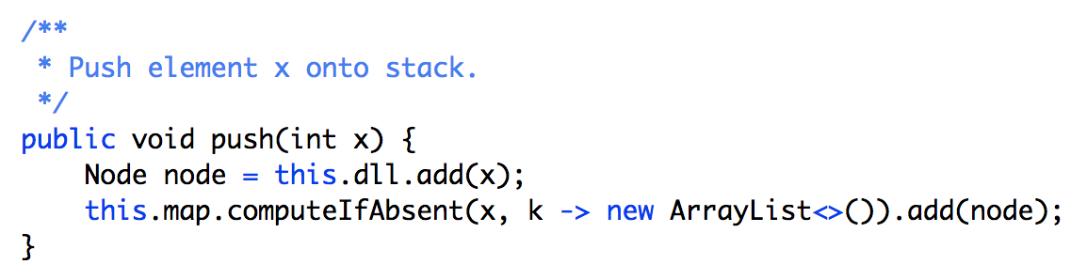
head
stack.push(5)
map
<5, [node 5]>
5
tail

Slide 47
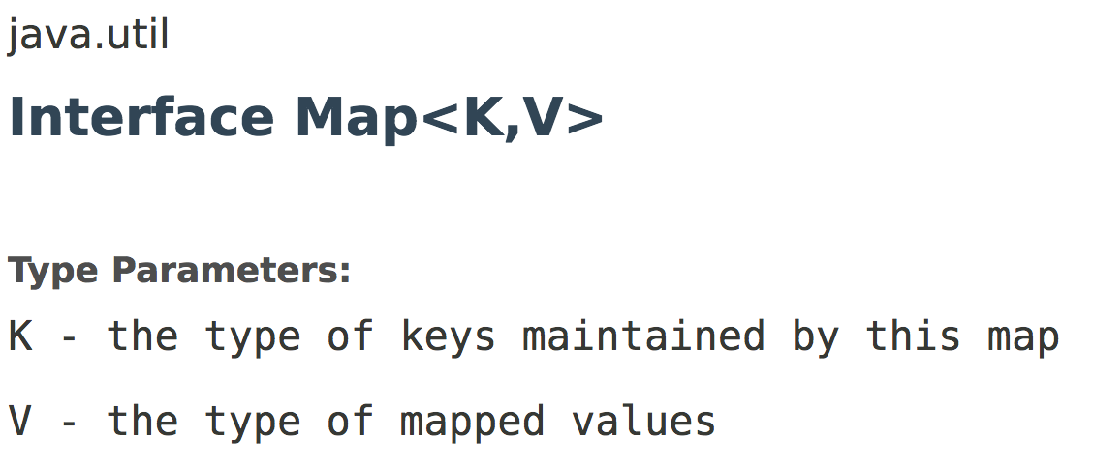
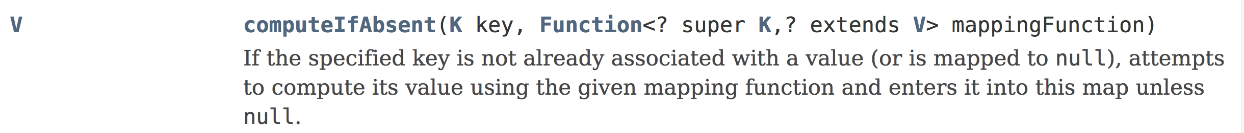

Slide 48
O(log(n))
head
stack.push(5)
stack.push(1)
5
map
<5, [node 5]>
<1, [node 1]>
1
tail

Slide 49
head
5
stack.push(5)
stack.push(1)
stack.push(5)
map
<5, [node 5, node 5]>
<1, [node 1]>
1
5
5
tail

Slide 50
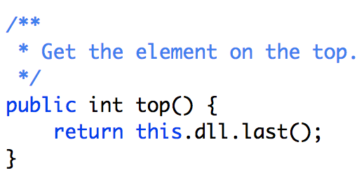
O(1)
head
5
stack.push(5)
stack.push(1)
stack.push(5)
stack.top()
map
<5, [node 5, node 5]>
<1, [node 1]>
1
5
5
tail

Slide 51
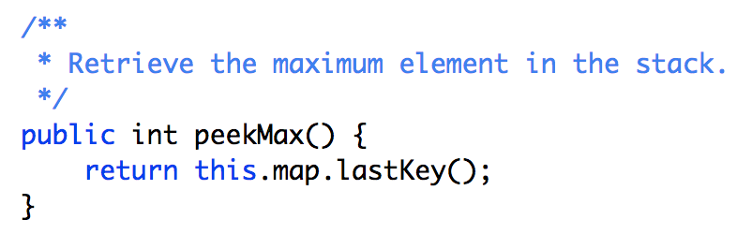
head
5
stack.push(5)
stack.push(1)
stack.push(5)
stack.top()
stack.popMax()
map
<5, [node 5, node 5]>
<1, [node 1]>
1
5
5
tail

Slide 52
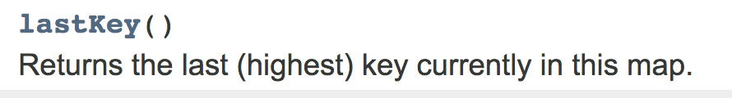
Runtime
O(log(n))
map
<5, [node 5, node 5]>
<1, [node 1]>

Slide 53
Runtime
O(log(n))
Go to rightest leaf

Slide 54
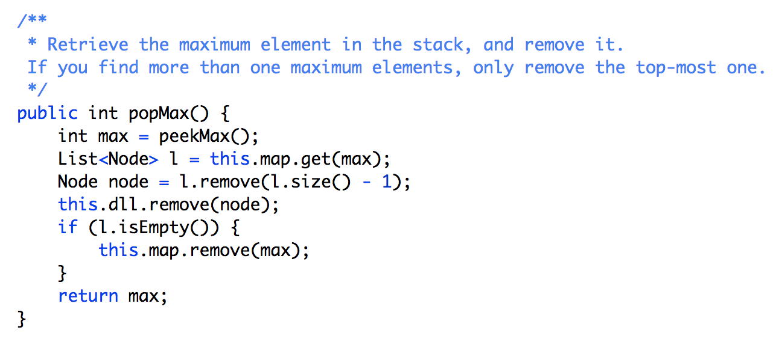
O(log(n))

Slide 55
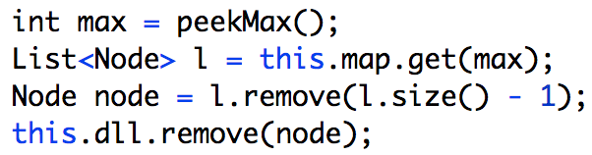
head
5
stack.push(5)
stack.push(1)
stack.push(5)
stack.top()
stack.popMax()
map
<5, [node 5, node 5]>
<1, [node 1]>
1
5
5
tail

Slide 56
head
5
stack.push(5)
stack.push(1)
stack.push(5)
stack.top()
stack.popMax()
map
<5, [node 5]>
<1, [node 1]>
1
tail

Slide 57
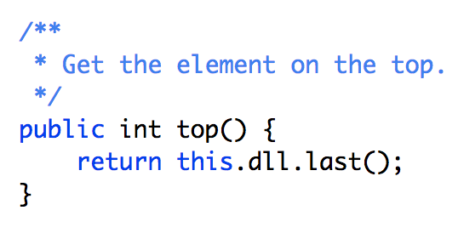
head
5
stack.push(5)
stack.push(1)
stack.push(5)
stack.top()
stack.popMax()
stack.top()
map
<5, [node 5]>
<1, [node 1]>
1
tail

Slide 58
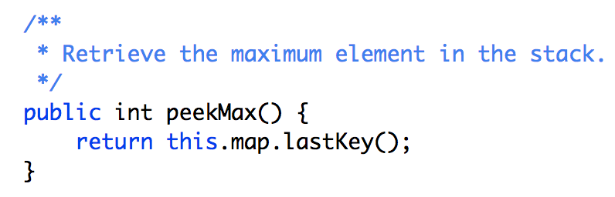
head
5
stack.push(5)
stack.push(1)
stack.push(5)
stack.top()
stack.popMax()
stack.top()
stack.peekMax()
map
<5, [node 5]>
<1, [node 1]>
1
tail

Slide 59

O(log(n))
O(log(n))

Slide 60

head
5
stack.push(5)
stack.push(1)
stack.push(5)
stack.top()
stack.popMax()
stack.top()
stack.peekMax()
stack.pop()
map
<5, [node 5]>
<1, [node 1]>
1
tail

Slide 61
head
5
stack.push(5)
stack.push(1)
stack.push(5)
stack.top()
stack.popMax()
stack.top()
stack.peekMax()
stack.pop()
map
<5, [node 5]>
tail

Slide 62
head
5
stack.push(5)
stack.push(1)
stack.push(5)
stack.top()
stack.popMax()
stack.top()
stack.peekMax()
stack.pop()
stack.top()
map
<5, [node 5]>
tail

Slide 63

Space Complexity
O(N), the size of DoubleLinkedList + TreeMap

Slide 64

Two Stacks
LIFO
Last In First Out

Slide 65

stack
maxStack

Slide 66


Slide 67

Empty
Scenario

Slide 68

O(n)

Slide 69
XCode Spring Cloud 课案文档：
https://quip.com/XPGSAX98Gb2q
XCode 2018 课案文档：
https://quip.com/E7FmAsFC3F2S
XCode 2017 课案文档：
https://quip.com/aCoTAb1SQfnD

Slide 70
Xcode Career Service
有任何问题，请咨询 xc0d3@outlook.com

Slide 71


Bloomberg 高频题
Flatten LinkedList

Slide 72
1
2
3
4
5
6
7
Flatten
8
1
2
5
6
8
7
3
4
class ListNode {
public int value;
public ListNode next;
public ListNode down;
}

Slide 73
Level 0
1
2
3
4
down
Level 1
5
6
7
down
Level 2
8
Level 0
Level 1
2
1
Level 0
1
2
5
6
8
7
3
4
down
down

Slide 74
Level 0
Level 1
2
1
Level 0
1
2
5
6
8
7
3
4
down
down
tail
tail
up
up
Tail is the end of current level

Slide 75

Recursion

Slide 76
tail
// Recursion function: return of current level
ListNode flatten(ListNode cur)
1
2
3
4
5
6
7
8

Slide 77
cur.next == null
cur is
tail
1
2
3
4
5
6
7
8

Slide 78
2
3
down
5
Level 0
Level 1
2
1
Level 0
1
2
5
6
8
7
3
4
down
down
tail
tail
up
up
Manipulate pointers:
Tail’s next points to parent level who has down’s next

Slide 79
6
7
down
8
Level 0
Level 1
2
1
Level 0
1
2
5
6
8
7
3
4
down
down
tail
tail
up
up
Manipulate pointers:
Tail’s next points to parent level who has down’s next

Slide 80

Find tail

Slide 81
// return current level’s tail
ListNode flatten(ListNode cur) {
if (cur.next == null) {
// tail
return cur;
}
return flatten(cur.next);
}

Slide 82

When we see down

Slide 83
cur
next
down
if (cur.down != null) {
ListNode down = cur.down;
ListNode next = cur.next;
ListNode tail = flatten(cur.down);
cur.down = null;
cur.next = down;
tail.next = next;
}

Slide 84
cur
down
tail
next
null
child level
if (cur.down != null) {
ListNode down = cur.down;
ListNode next = cur.next;
ListNode tail = flatten(cur.down);
cur.down = null;
cur.next = down;
tail.next = next;
}

Slide 85

Put it together

Slide 86
ListNode flatten(ListNode cur) {
if (cur.down != null) {
ListNode down = cur.down;
ListNode next = cur.next;
ListNode tail = flatten(cur.down);
cur.down = null;
cur.next = down;
tail.next = next;
}
if (cur.next == null) {
// tail
return cur;
}
return flatten(cur.next);
}

Slide 87

Iterative

Slide 88
Use Stack for Recursion
Stack<ListNode> s = new Stack<>();
ListNode cur = head;
while (cur != null) {
// Magic here
cur = cur.next;
}

Slide 89
When we see down

Slide 90
cur
next
down
if (cur.down != null) {
ListNode down = cur.down;
ListNode next = cur.next;
if (next != null) {
s.add(next);
}
cur.down = null;
cur.next = down;
}

Slide 91
cur
down
new cur
Now we are on child level
null
next
if (cur.down != null) {
ListNode down = cur.down;
ListNode next = cur.next;
if (next != null) {
s.add(next);
}
cur.down = null;
cur.next = down;
}
stack

Slide 92
When we see tail

Slide 93

tail
next
stack

Slide 94
child level
parent level
tail
cur
cur = next;

Slide 95
Put it together

Slide 96



Slide 97
XCode Spring Cloud 课案文档：
https://quip.com/XPGSAX98Gb2q
XCode 2018 课案文档：
https://quip.com/E7FmAsFC3F2S
XCode 2017 课案文档：
https://quip.com/aCoTAb1SQfnD

Slide 98
Xcode Career Service
有任何问题，请咨询 xc0d3@outlook.com

Slide 99

谷歌难题
Longest Mountain in Array

Slide 100


Slide 101


Slide 102
题目大意：
求数组中的最长“山峰”的长度
“山峰”的定义为：存在 0 < i < B.length - 1 使得 B[0] < B[1] < ... B[i-1] < B[i] > B[i+1] > ... > B[B.length - 1]
解题思路：
分别从左往右、从右往左遍历数组
辅助数组left记录某数字左侧的最长递增子串的长度
辅助数组right记录数字右侧的最长递减子串的长度

Slide 103
(3, 7)
(6, 5)
(2, 4)
(4, 3)
(0, 2)
(5, 2)
(1, 1)
y: [2, 1, 4, 7, 3, 2, 5]
x: [0, 1, 2, 3, 4, 5, 6]

Slide 104
(3, 7)
(6, 5)
(2, 4)
(4, 3)
(0, 2)
(5, 2)
left
[0, 0, 1, 2, 0, 0, 1]
(1, 1)

Slide 105
(3, 7)
(6, 5)
(2, 4)
(4, 3)
(0, 2)
(5, 2)
left
[0, 0, 1, 2, 0, 0, 1]
(1, 1)

Slide 106
(3, 7)
(6, 5)
(2, 4)
(4, 3)
(0, 2)
(5, 2)
left
[0, 0, 1, 2, 0, 0, 1]
(1, 1)

Slide 107
(3, 7)
(6, 5)
(2, 4)
(4, 3)
(0, 2)
(5, 2)
left
[0, 0, 1, 2, 0, 0, 1]
(1, 1)

Slide 108
(3, 7)
(6, 5)
(2, 4)
(4, 3)
(0, 2)
(5, 2)
left
[0, 0, 1, 2, 0, 0, 1]
(1, 1)

Slide 109
(3, 7)
(6, 5)
(2, 4)
(4, 3)
(0, 2)
(5, 2)
left
[0, 0, 1, 2, 0, 0, 1]
(1, 1)

Slide 110
(3, 7)
(6, 5)
(2, 4)
(4, 3)
(0, 2)
(5, 2)
left
[0, 0, 1, 2, 0, 0, 1]
(1, 1)

Slide 111
(3, 7)
(6, 5)
(2, 4)
(4, 3)
(0, 2)
(5, 2)
right
[1, 0, 0, 2, 1, 0, 0]
(1, 1)

Slide 112
(3, 7)
(6, 5)
(2, 4)
(4, 3)
(0, 2)
(5, 2)
right
[1, 0, 0, 2, 1, 0, 0]
(1, 1)

Slide 113
(3, 7)
(6, 5)
(2, 4)
(4, 3)
(0, 2)
(5, 2)
right
[1, 0, 0, 2, 1, 0, 0]
(1, 1)

Slide 114
(3, 7)
(6, 5)
(2, 4)
(4, 3)
(0, 2)
(5, 2)
right
[1, 0, 0, 2, 1, 0, 0]
(1, 1)

Slide 115
(3, 7)
(6, 5)
(2, 4)
(4, 3)
(0, 2)
(5, 2)
right
[1, 0, 0, 2, 1, 0, 0]
(1, 1)

Slide 116
(3, 7)
(6, 5)
(2, 4)
(4, 3)
(0, 2)
(5, 2)
right
[1, 0, 0, 2, 1, 0, 0]
(1, 1)

Slide 117
(3, 7)
(6, 5)
(2, 4)
(4, 3)
(0, 2)
(5, 2)
left
[0, 0, 1, 2, 0, 0, 1]
(1, 1)
right
[1, 0, 0, 2, 1, 0, 0]

Slide 118


Slide 119

Runtime 2n
Space 2n

Slide 120

Improve Space
cur
prev
left[i]
left[i - 1]

Slide 121


Slide 122

Runtime 2n
Space n

Slide 123


Improve Space and Runtime

Slide 124


Slide 125
cur: 0
status: INVALID
(3, 7)
(6, 5)
(2, 4)
(4, 3)
(0, 2)
(5, 2)
(1, 1)

Slide 126

cur: 0
status: INVALID
(3, 7)
(6, 5)
(2, 4)
(4, 3)
(0, 2)
(5, 2)
(1, 1)

Slide 127

cur: 2
status: UP
(3, 7)
(6, 5)
(2, 4)
(4, 3)
(0, 2)
(5, 2)
(1, 1)

Slide 128
cur: 3
status: UP
(3, 7)
(6, 5)
(2, 4)
(4, 3)
(0, 2)
(5, 2)
(1, 1)

Slide 129
cur: 4
status: DOWN
(3, 7)
(6, 5)
(2, 4)
(4, 3)
(0, 2)
(5, 2)
(1, 1)

Slide 130
cur: 5
status: DOWN
(3, 7)
(6, 5)
(2, 4)
(4, 3)
(0, 2)
(5, 2)
(1, 1)

Slide 131
cur: 2
status: UP
(3, 7)
(6, 5)
(2, 4)
(4, 3)
(0, 2)
(5, 2)
(1, 1)

Slide 132

Runtime n
Space O(1)

Slide 133
变种
(3, 7)
(6, 5)
(2, 4)
(4, 3)
(0, 2)
(5, 2)
(7, 1)
(1, 1)

Slide 134


Slide 135
[1, 2, 2, 1, 1, 3, 3, 4, 5]
[1, 2, 1, 5, 4, 3, 3, 2, 1]
[1, 2, 3, 4, 5, 7, 6]
[1, 2, 3, 4, 5, 6, 7]
[1, 2, 3, 4, 5, 6, 7]
[7, 6, 5, 4, 3, 2, 1]
Next Permutation

Slide 136
Start from its last element, traverse backward to find the first one with index i that satisfy num[i-1] < num[i].
So, elements from num[i] to num[n-1] is reversely sorted.
To find the next permutation, we have to swap some numbers at different positions, to minimize the increased amount, we have to make the highest changed position as high as possible. Notice that index larger than or equal to i is not possible as num[i,n-1] is reversely sorted. So, we want to increase the number at index i-1, clearly, swap it with the smallest number between num[i,n-1] that is larger than num[i-1]. For example, original number is 121543321, we want to swap the '1' at position 2 with '2' at position 7.
The last step is to make the remaining higher position part as small as possible, we just have to reversely sort the num[i,n-1]

Slide 137
Find rightmost number that can be replaced with a bigger number from its right side
1, 2, 1, 5, 4, 3, 3, 2, 1

Slide 138
Replaced with a bigger number from its right side
You want the smallest number that is bigger than it
1, 2, 1, 5, 4, 3, 3, 2, 1
1, 2, 2, 5, 4, 3, 3, 1, 1

Slide 139
Make its right side smallest now that current digit is already bigger than before
1, 2, 1, 5, 4, 3, 3, 2, 1
1, 2, 2, 5, 4, 3, 3, 1, 1
1, 2, 2, 1, 1, 3, 3, 4, 5

Slide 140

1, 2, 1, 5, 4, 3, 3, 2, 1
1, 2, 2, 5, 4, 3, 3, 1, 1
1, 2, 2, 1, 1, 3, 3, 4, 5

Slide 141


Slide 142
[1, 2, 2, 1, 1, 3, 3, 4, 5]
[1, 2, 1, 5, 4, 3, 3, 2, 1]
[1, 2, 3, 4, 5, 7, 6]
[1, 2, 3, 4, 5, 6, 7]
[1, 2, 3, 4, 5, 6, 7]
[7, 6, 5, 4, 3, 2, 1]
Previous Permutation

Slide 143
Start from its last element, traverse backward to find the first one with index i that satisfy num[i-1] > num[i].
So, elements from num[i] to num[n-1] is sorted.
To find the next permutation, we have to swap some numbers at different positions, to minimize the decreased amount, we have to make the highest changed position as high as possible. Notice that index larger than or equal to i is not possible as num[i,n-1] is sorted.
So, we want to decrease the number at index i-1, clearly, swap it with the smallest number between num[i,n-1] that is smaller than num[i-1].
For example, original number is 122543311, we want to swap the '2' at position 2 with '1' at position 7.
The last step is to make the remaining higher position part as small as possible, we just have to reversely sort the num[i,n-1]

Slide 144

1, 2, 2, 1, 1, 3, 3, 4, 5
1, 2, 1, 1, 2, 3, 3, 4, 5
1, 2, 1, 5, 4, 3, 3, 2, 1

Slide 145
Xcode Career Service
有任何问题，请咨询 xc0d3@outlook.com

